Slide 1

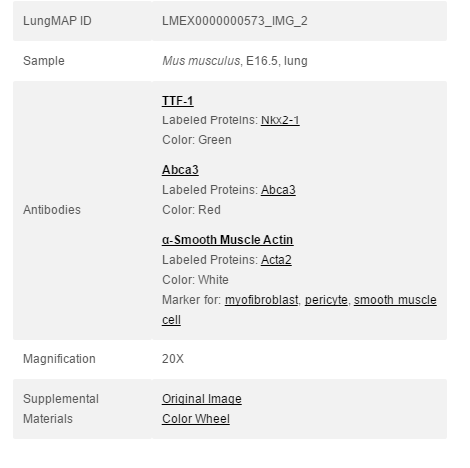
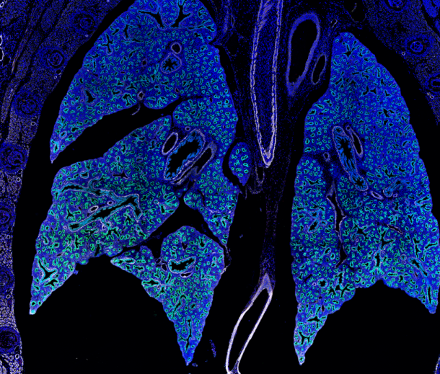





LungMap
Introduction | Purpose and Strategy
Purpose: develop a statistical learning pipeline to automatically classify immunofluorescent images of developing mouse lungs in the LungMAP database
Purpose and Strategy
Image Segmentation
Strategy:
Results and Future Steps
Lung Image
Extract metadata from the image by using SPARQL queries
Image Metadata
Segment the image using parameters defined by the metadata information
Image
Number of Bronchioles
Number of Acinar Tubules
Percentage area of muscle
Etc…
Annotate the image by pointing out the structures found with the segmentation
Image information file
JSON file containing segmentation data
LungMap project
Pablo Ortiz
Vivek Sriram
Lina Yang

Slide 2

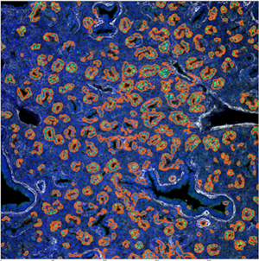
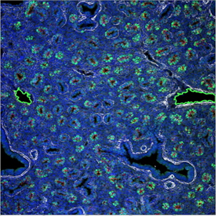
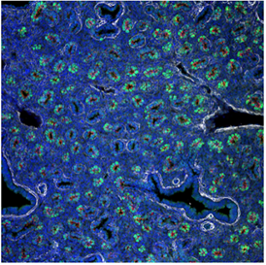
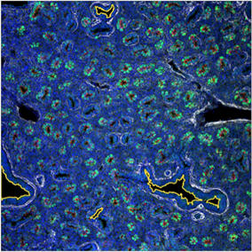
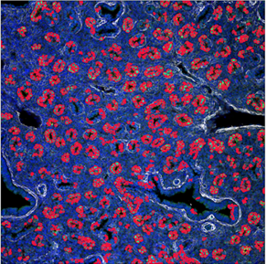
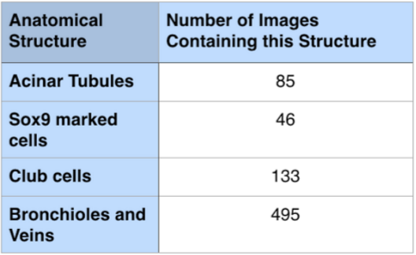
Progress | Image Segmenting
Using information gathered from the metadata for each image, we determine the specific combination of segmentation rules we wish to apply, as different images
LungMap
Purpose and Strategy
Image Segmentation
We apply Gaussian blurring and normalization of colors, as well as area and color thresholding, to pick out the specific structures or cells that we want to identify
Results and Future Steps
Acinar Tubule
Veins and Arteries
The images to the left depict various types of segmentation of the same image, all for different structures
Area Threshold: 400 pixels
Color: Green
Normalization of Green: Yes
Area Threshold: 3000 pixels
Color: White
Normalization of Green: No
Original Image
Data from the segmentation
Bronchioles
Sox9 marked cells
LungMap project
Pablo Ortiz
Vivek Sriram
Lina Yang
Area Threshold: 3000 pixels
Color: Blue
Normalization of Green: No
Area Threshold: 100 pixels
Color: Green
Normalization of Green: Yes

Slide 3

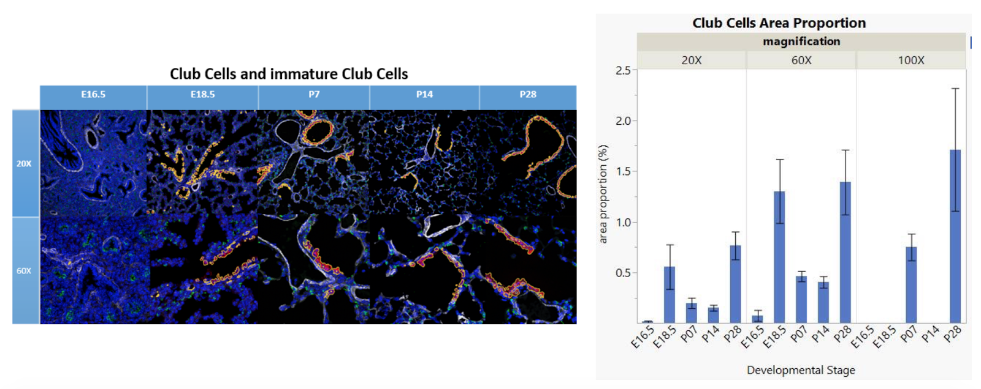
Conclusion | Results and Future Steps
LungMap
Results:
Purpose and Strategy
Data from various types of images from lungs at different stages of development
Image Segmentation
Results and Future Steps
Future Steps:
Developing pipeline for higher resolution image segmentation to detect more entity types.
Making segmentation rules more robust with better normalization and the use of different algorithms
Making functions more flexible and generic
Enhancing web application usability and features
Integrating of pipeline and web visualization application into LungMAP website
LungMap project
Pablo Ortiz
Vivek Sriram
Lina Yang

